Slide 1

“CLOUD SOLUTIONS POWER BIGDATA TECHNOLOGIES “
The Future of Big Data and Machine Learning Is Clear: It’s All on the Cloud
Monika M – 20BIS025

Slide 2

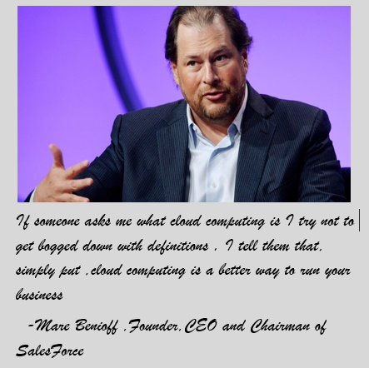
“Data and Cloud “

Slide 3
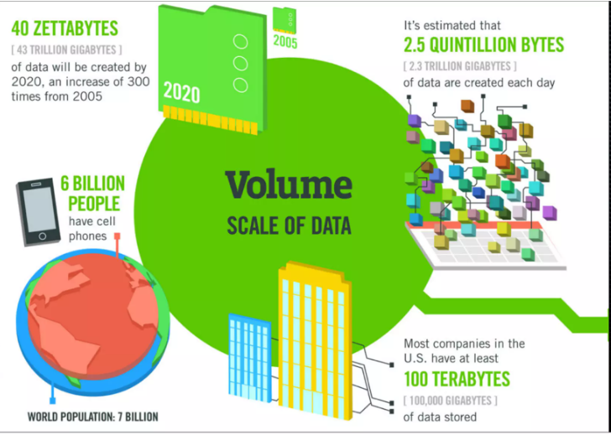
Big Data
In 2005, Tim O’Reilly published his groundbreaking article “What is Web 2.0?”. In this article, Tim O’Reilly states that the “data is the next Intel inside”.
O’Reilly Media explicitly used the term ‘Big Data’ to refer to the large sets of data which is almost impossible to handle and process using the traditional business intelligence tools.
In 2005 Yahoo used Hadoop to process petabytes of data which is now made open-source by Apache Software Foundation. Many companies are now using Hadoop to crunch Big Data.
We can say that 2005 is the year that the Big data revolution has truly begun and the rest they say is history.

Slide 4
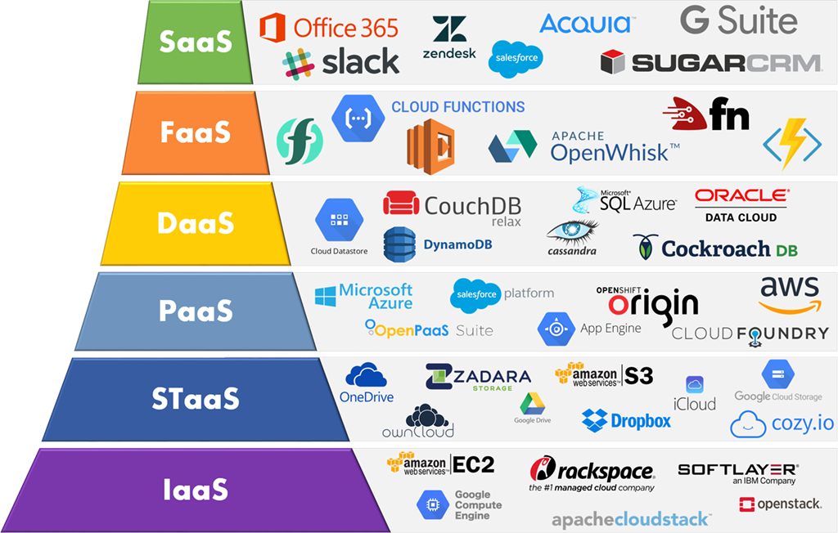
Cloud Solutions :
Cloud solutions, also known as cloud computing or cloud services, deliver IT resources especially data storage (cloud storage) and computing power on demand over the Internet without direct active management by the user
Cloud computing relies on sharing of resources to achieve coherence and typically uses a "pay as you go" model, which can help in reducing capital expenses

Slide 5
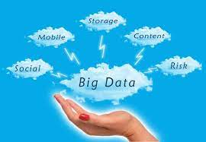
Big data and the cloud – a match made in heaven ?
Big data involves huge volume of data generated at higher velocity .
To process these big data ,we can’t use any on –premises options such as in-house data warehouse or power up more server.
That where the cloud comes in.
Cloud supports large storage and real time processing.
Currently big data involves petabytes but soon it may be exabytes and zettabytes , to process these we should need cloud solution.
Cloud also allows connectivity and collaboration all over the world through internet.

Slide 6
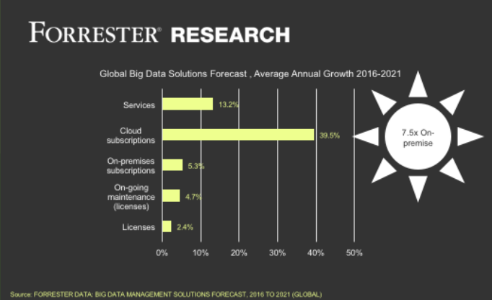
Why big data in the cloud makes perfect sense??🤔
A Forrester Research survey in 2017 revealed that big data solutions via cloud subscriptions will increase about 7.5 times faster than on-premise options.

Slide 7
Interesting facts about Cloud :
According to an estimate made by industry experts, by 2022, 40 Zettabytes of data will be held in the cloud; this is a huge figure indeed.
Corporates store 60% of their data in the cloud.
The three sectors that plan to spend the most on cloud computing services are manufacturing ($19.7 billion), professional services ($18.1 billion), and banking ($16.7 billion).
The average employee uses 36 cloud-based services in their daily routine.
81% of all enterprises have a multi-cloud strategy already laid out or in the works.
Amazon Web Services has the largest cloud computing market share at 32%.
The public cloud market will grow by $482 billion in 2022.
Dropbox continues to be the leading cloud storage provider with 47.3%. Other top services include Google Drive (26.9%) and Microsoft OneDrive (15.3%).
Between 2022 and 2032, the cloud computing industry will be worth $1, 949 billion.

Slide 8

Merging the Cloud
and
Big Data Technologies
Cloud solution makes easier to store and compute big data in most efficient way
Cloud computing reduces enormous amount of equipment needed for storage , retrieval and processing of big data .
Techniques to analyze data such as machine learning and natural language processing.
Big Data Technologies such as cloud computing and business intelligence.
Visualization such as charts, graphs, and other methods to display data.

Slide 9
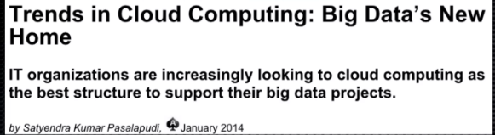
Big data and cloud in Business and Technology world
Big data in the cloud changed the business and the technology world . It turned out to be the perfect solution for many companies. It doesn’t require any on-premise infrastructure, which greatly reduces startup costs. It also doesn’t require the same amount of data gurus on the team because of how much can be done by the cloud company itself. Big data in the cloud has been one of the key components in big data’s quick ascent in the business and technology world. Big data in the cloud is also vital because of the growing amount of information each day.
It’s extremely hard to scale your infrastructure when you’ve got an on-premise set up to meet your information needs. You have to install more hardware for more data or waste space and money with unused hardware when the data is less than expected. That problem doesn’t exist with big data in the cloud. Companies can scale up and down as their needs require, without significant financial cost.
“You don’t want to be shipping terabytes and petabytes around. Keep the data where it is , and then you move the analytics to that data “

Slide 10
The potential of Big Data and Cloud Computing Systems
Boost productivity: As Big Data and cloud computing systems join to render high-performance computing on servers and perform analytic processing, organizations gain insights quickly and are freed-up to concentrate on other aspects of the business.
Innovation: Cloud Big Data technologies enable and foster an innovative environment to help teams use the cloud to store more data and discover new, powerful insights
Real-time analysis: With the speed and flexibility offered by the latest technologies of Big Data and cloud computing systems, companies work efficiently by leveraging real-time analysis from the latest and most up-to-date data. Predictive analysis is also performed in near real-time, helping analysts interpret and act on insights quickly.
Quick data processing: Data processing has evolved to the point where it takes just a few minutes to be executed. Big Data analytics platforms and computing systems can take unstructured data and merge it with structured data on the go to uncover opportunities instantly.
Cost-efficient infrastructure: Cloud computing systems and platforms offer cost-efficient and cost-effective alternatives to manage and maintain data, based on the client’s budget. Investment in infrastructure is minimal as the cloud provider covers this aspect along with models where you only pay for what you actually use.

Slide 11
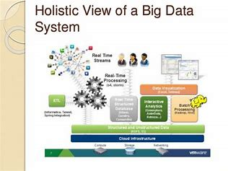
Cloud technology designed for big data uses:
Cloudera is fully functional Cloudera Hadoop cluster on AWS cloud.
Companies like Google(google cloud),Microsoft(Microsoft Azure),Amazon(AWS) and IBM continue to release new machine learning features on top of their cloud platforms and inside their cloud applications, making them look like more appealing place to store data as well
Oracle announced a platform as a service(PAAS) offering.

Slide 12
Cloud technology designed for big data uses(cont)
The Hortonworks Data platforms is now fully certified with Microsoft Azure, meaning users can run the same software and get the same experience as on their own data centre.
Microsoft’s HDInsight Hadoop Service now supports the storm stream processing framework.
Rackspace launched a big data version of its bare-metal cloud service, promising deployment of a Hadoop-spark cluster in just a few clicks.
Tableau announced a beta version of a connector for Amazon Elastic MapReduce ,which let users pull data from the cloud service for analysis in Tableau.

Slide 13

Big Data Cloud Solutions
Big Data Analytics from Google
Big Data Analytics from the Google Cloud Platform provides the capability of leveraging serverless data analytics in a machine learning platform. The Google Cloud Platform takes care of the complexities of data analytics to accelerate the delivery of insights with a serverless approach that helps avoid operational overhead.
Additionally, the Google Cloud Platform enables users to build data lakes to capture every piece of data, which can run up to petabytes or exabytes in size, and apply numerous processing techniques to extract valuable insights.

Slide 14
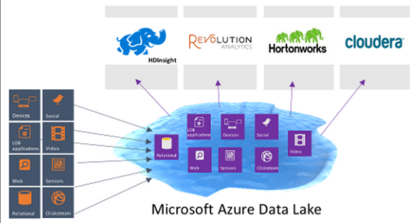
Data Lakes on Microsoft Azure
Microsoft Azure’s data lakes provide a wide array of capabilities to “make it easy for developers, data scientists, and analysts to store data of any size, shape, and speed, and do all types of processing and analytics across platforms and languages.
” The Microsoft Azure data lake is a highly scalable public cloud service that simplifies data management to gain insight from massive data sets by integrating seamlessly with stores and data warehouses to extend its reach. It is comprised of data storage and data analytics

Slide 15
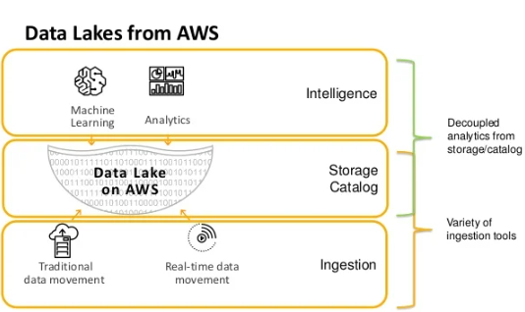
Data Lakes and Analytics on AWS
Amazon web service offers a comprehensive portfolio of secure, scalable, and cost-effective services that enable companies to build data lakes and analytics solutions. With a powerful suite of services to build and manage a data lake, AWS is at the forefront of data lake offerings.
AWS offers these four services to move, store, and analyze data to build data lakes and analytics solutions:
Data movement to import data in real-time.
Data lake to store any type and size of data.
Analytics to analyze data thoroughly.
Machine Learning to predict future outcomes and deploy quick responses.

Slide 16
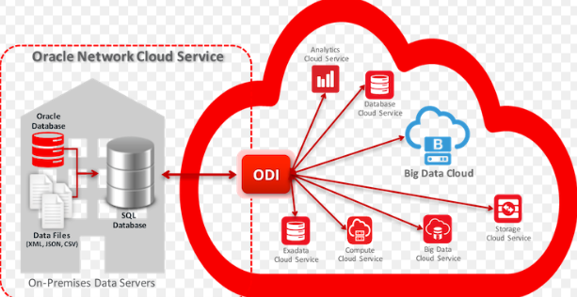
Big Data on Oracle Cloud
Oracle offers the Oracle Big Data Cloud Service which consists of “an automated service that provides a high-powered environment tailor-made for advancing businesses’ analytical capabilities.
” This Big Data service from Oracle enables companies to access services at the cost and capability level that is best suited for their needs. The solution combines Oracle’s rich analytics platform with Hadoop’s distribution in a seamless, integrated, and secure Data Lake.

Slide 17


Pros of putting big data in the cloud
Requires zero CAPEX
Enables faster scalability
Lowers the cost of analytics
Encourages an agile and innovative culture
Enables better business continuity and disaster recovery
Potential challenges of big data in the cloud
Less control over security
Less control over compliance
Network dependency and latency issues

Slide 18
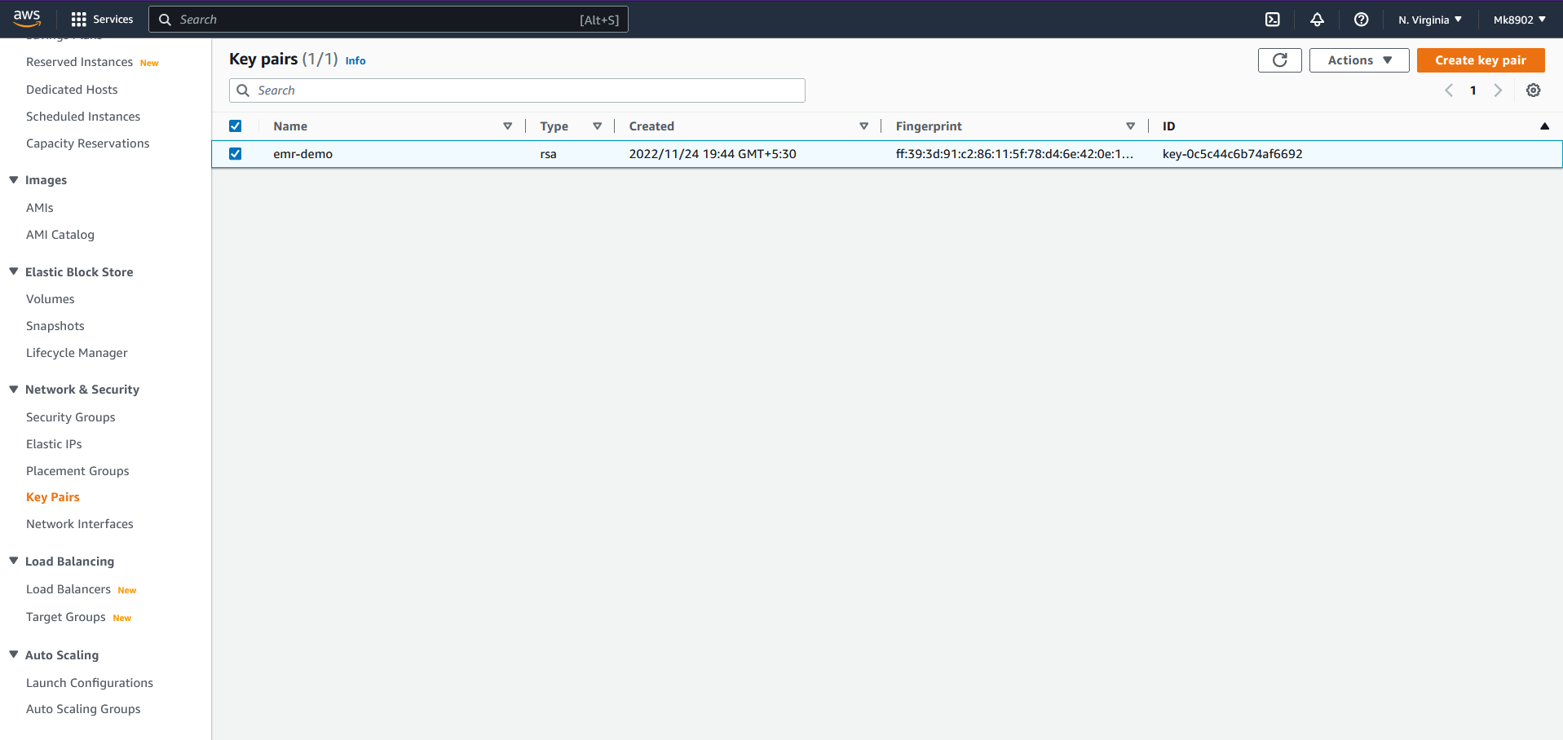
Implementation:AWS EMR Big Data Processing with Spark and Hadoop
Step 1: Create a key –pair in AWS

Slide 19
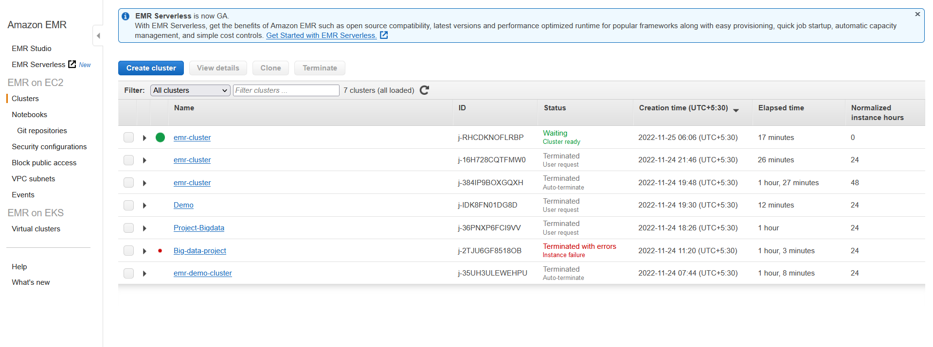
Step 2: Search EMR and create cluster The created EMR has both Hadoop and spark.

Slide 20
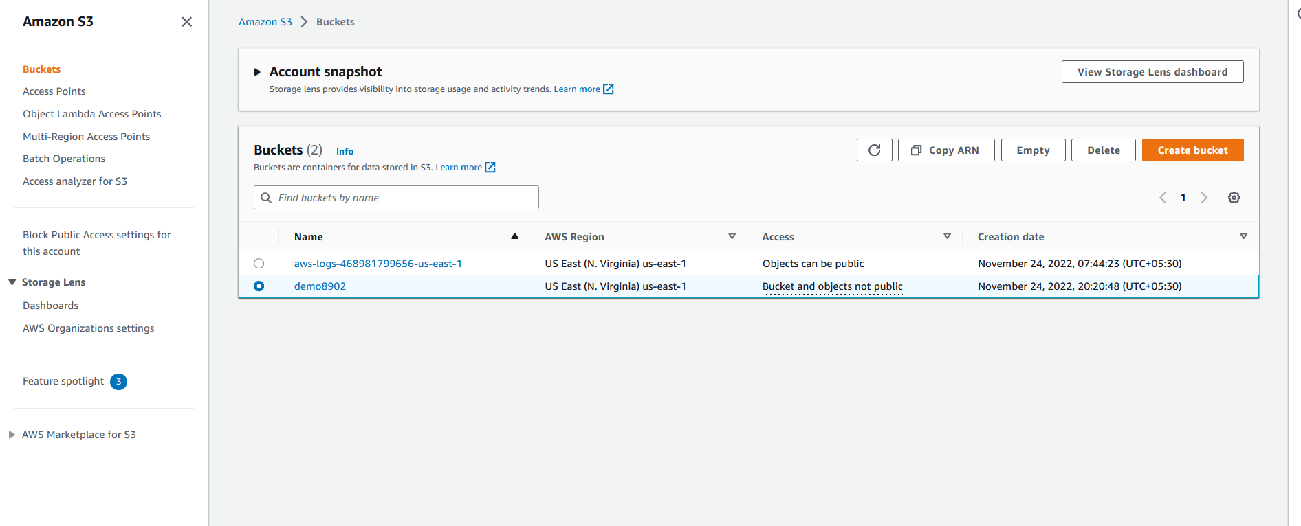
S3 Bucket Creation Step 3:Search and Create S3 Bucket for storage

Slide 21
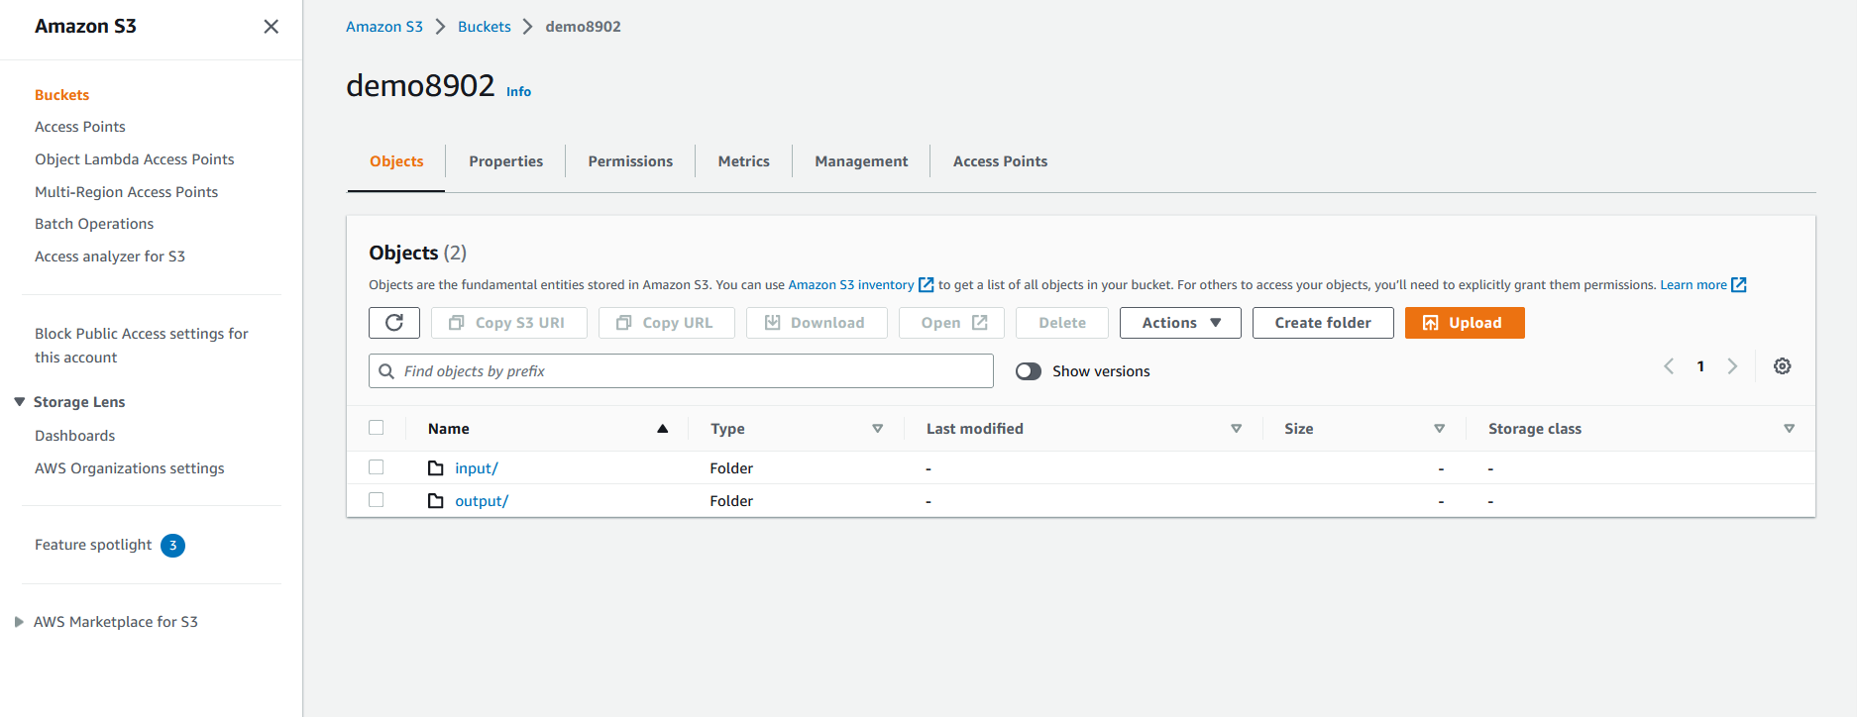
Step 4: Create 2 folders(input and output) on the bucket

Slide 22
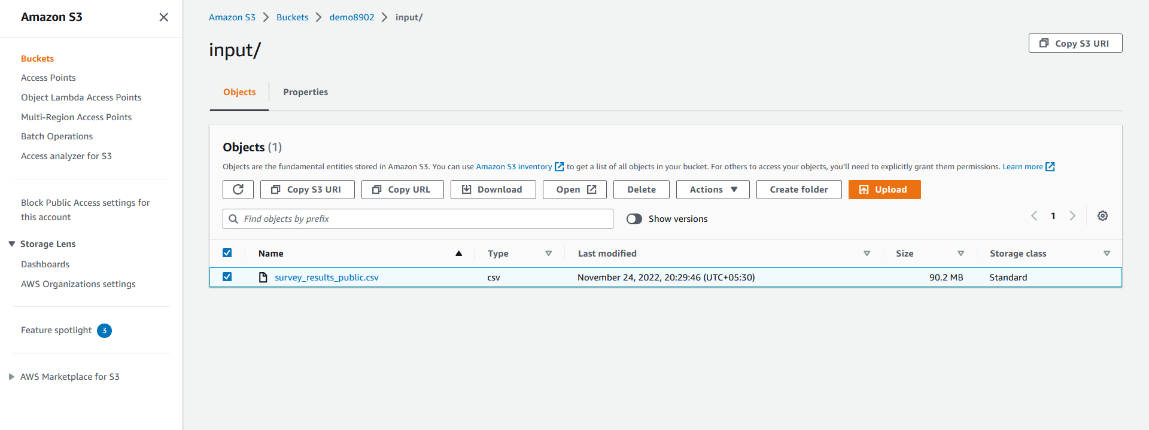
Step5: Upload the file which needs to be analysed in the input folder

Slide 23
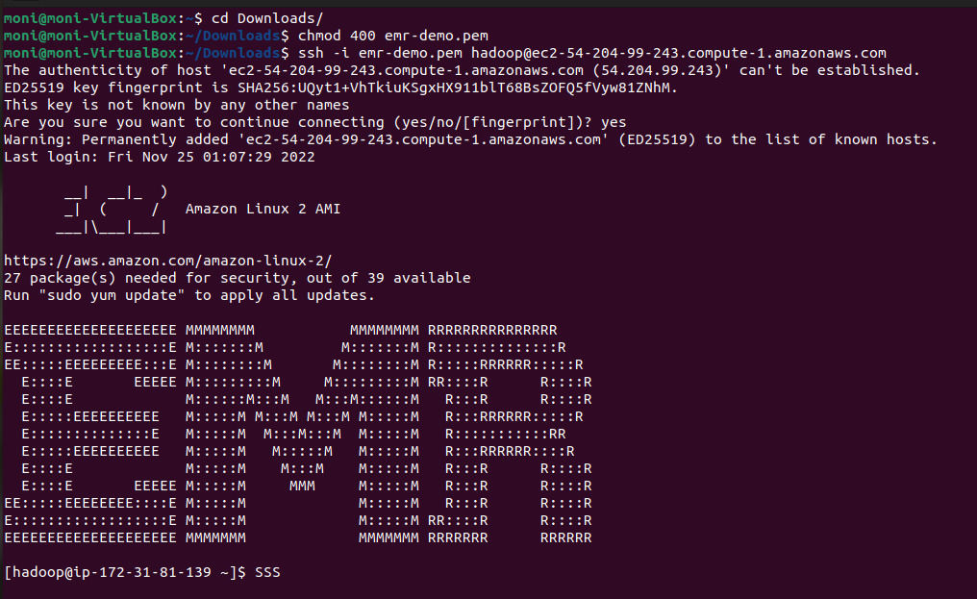
Step 6: Connect to the master node using SSH
Commands:
cd Downloads/
chmod 400 emr-demo.pem
ssh -i emr-demo.pem hadoop@ec2-54-204-99-243.compute-1.amazonaws.com

Slide 24
Simple Python and Pyspark code to process Big data
from pyspark.sql import SparkSession
from pyspark.sql.functions import col
S3_DATA_INPUT_PATH = 's3://demo8902/input/survey_results_public.csv'
S3_DATA_OUTPUT_PATH = 's3://demo8902/output/'
def main():
spark = SparkSession.builder.appName('MonikaDemoProject').getOrCreate()
all_data = spark.read.csv(S3_DATA_INPUT_PATH, header=True)
print('Total number of records in the file : %s' % all_data.count())
selected_data = all_data.where((col('Country')=='United States') & (col('WorkWeekHrs')>45))
print('The number of engineers in US who work more than 45hrs in a week are: %s' % selected_data.count())
selected_data.write.mode('overwrite').parquet(S3_DATA_OUTPUT_PATH)
print('Selected data was sucessfully saved to s3 : %s' % S3_DATA_OUTPUT_PATH)
if __name__ == '__main__':
main()

Slide 25
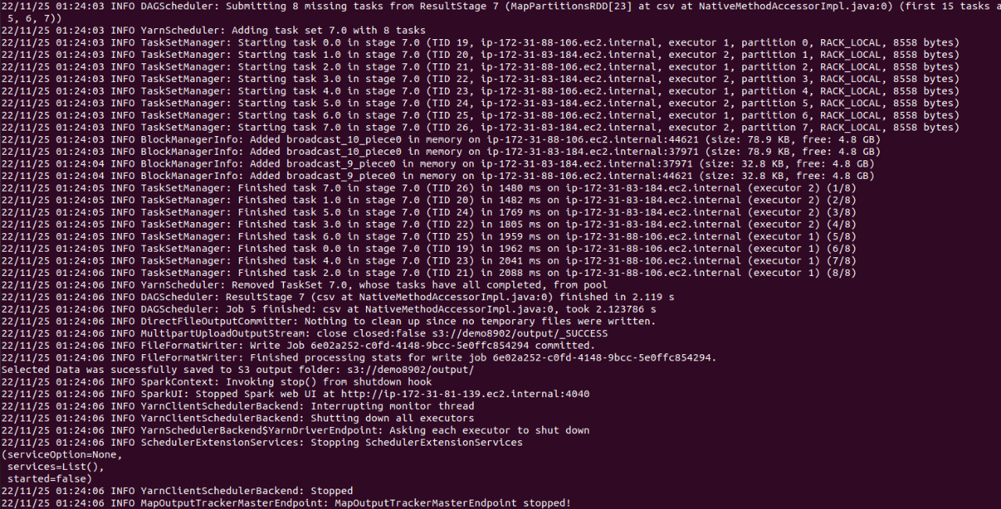
Result :

Slide 26
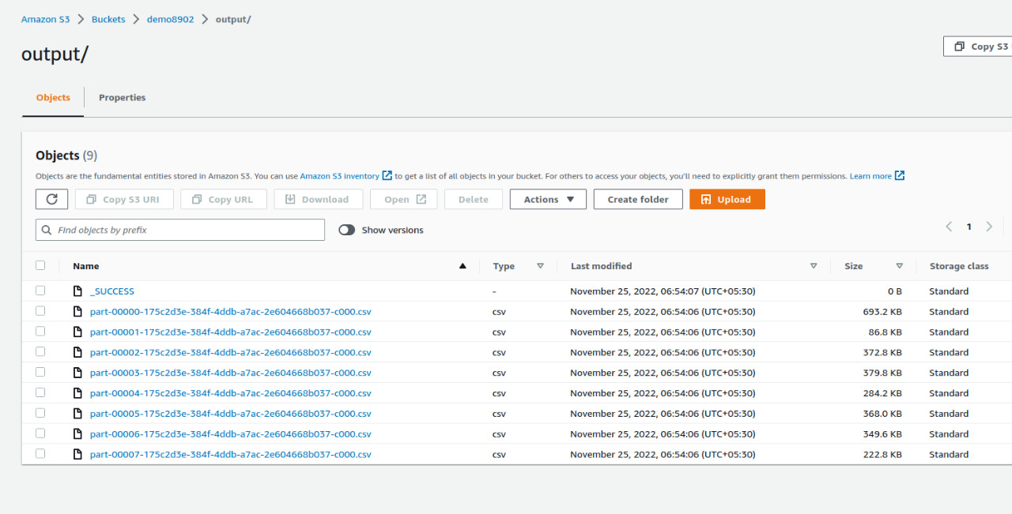
The results gets stored in output folder (You can also the download the output files)

Slide 27
References
https://www.slideshare.net/SateeshReddyN/cloudbased-big-data-analytics
https://www.slideshare.net/eric_yh_tsui/cloud-computing-big-data-for-servicde-innovation-learning
https://www.slideshare.net/microlife/bigdata-cloudcomputingvietstack
https://thorntech.com/big-data-in-the-cloud/
https://www.slideshare.net/MinhazulArefin2/the-rise-of-big-data-on-cloud-computing
https://www.slidegeeks.com/business/product/big-data-processing-in-cloud-computing-ppt-powerpoint-presentation-model-gallery

Slide 28
Thank you!!

